Slide 1
CENG-322 TEAM PROJECT
PetasosExpress
By Hermes Logistics Group 1

Slide 2
Members:
Group 1
Illia Myrza Popov (n01421791) - Distance and GPS sensors
Ahmad Aljawish (n01375348) - Balance Sensor
William Margalik (n01479878) - Motor Sensor
Dylan Ashton (n01442206) - Proximity Sensor

Slide 3
What Exactly is PetasosExpress?
Introducing PetasosExpress, the future of delivery! Experience swift, secure, and hassle-free deliveries with our advanced autonomous robots and intuitive app. Order, schedule pickups, and track deliveries seamlessly.
Welcome to the future of delivery!

Slide 4

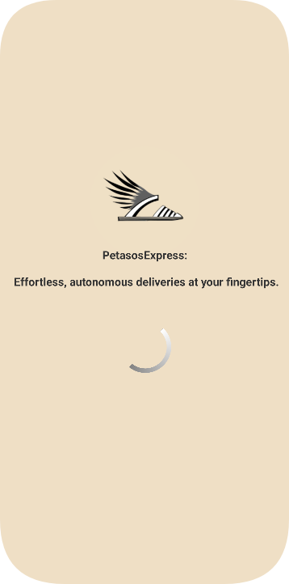
The functions and screen our delivery app provides:
Login Screen
Home Screen
GPS (Google Maps Interaction Menu)
App Settings Configuration
Help - If The Client Requires Assistance
Different Sensors That The Client Can Interact with!
Balance Sensor
Distance Sensor
Proximity Sensor
Motors Sensor

Slide 5
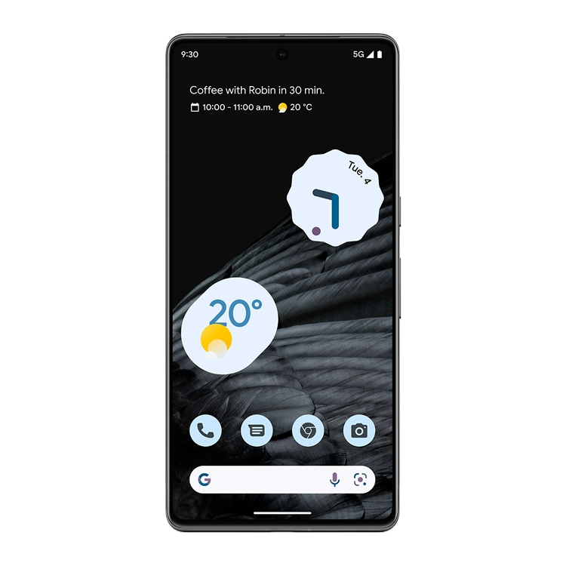
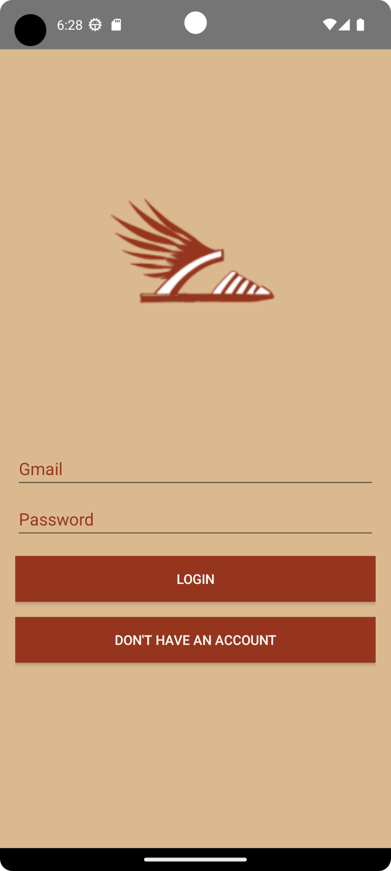
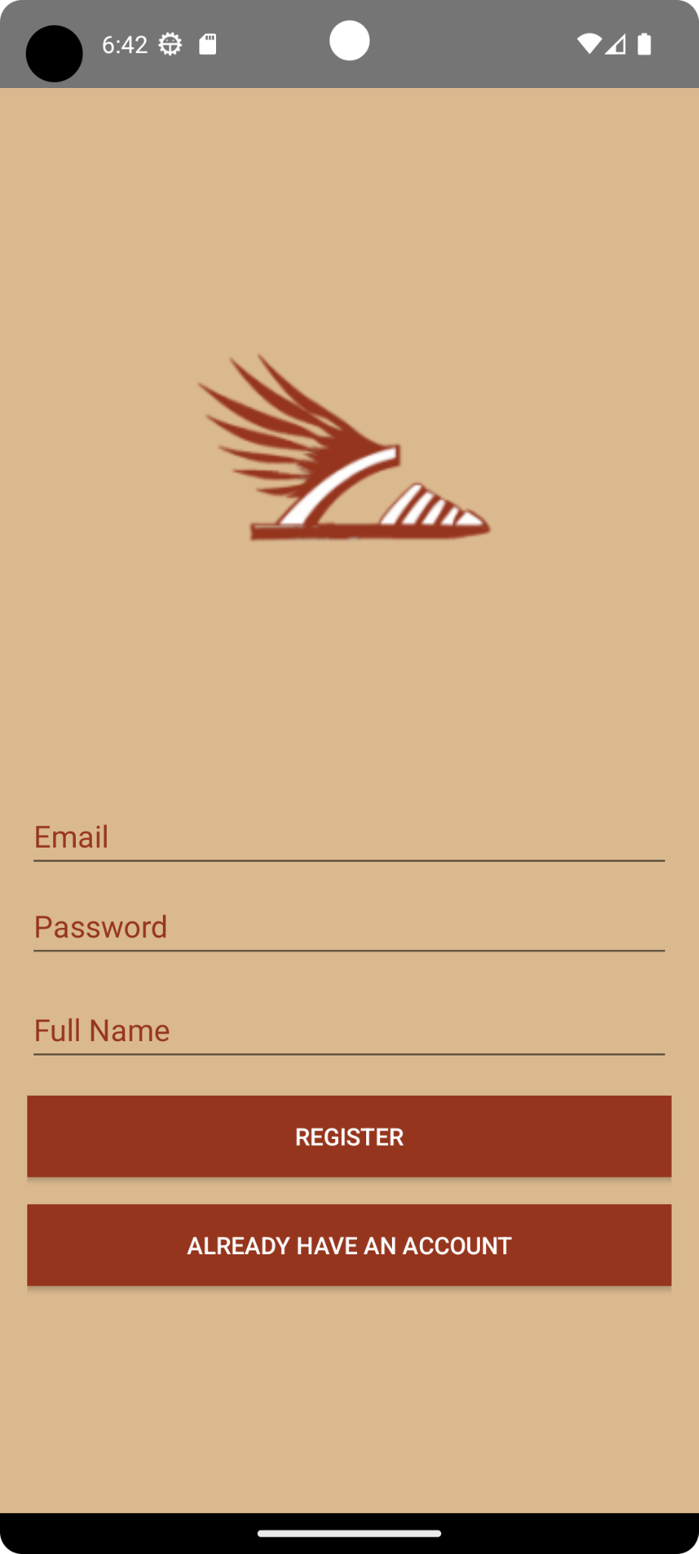
Authentication screens
Login Screen:
Takes user Gmail and verifies if it exists in App’s database. Then App checks if the password corresponds to the Gmail. On success goes to the main screen.
Registration:
Takes users’ input (Gmail and password) and creates an account in the database. On success proceeds to the main screen.

Slide 6
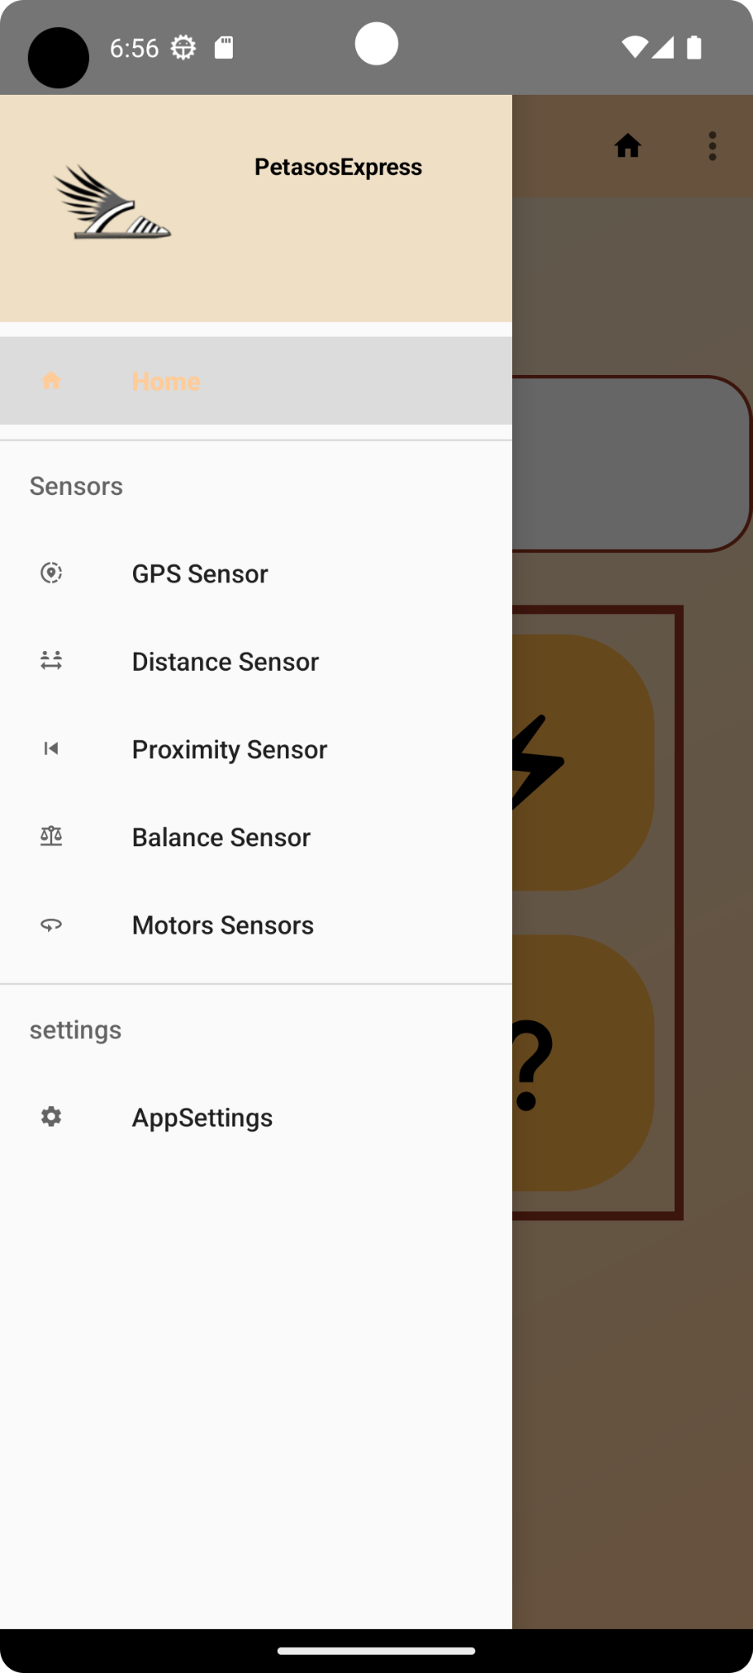
Navigation between Screens
Intuitive Access:
Provides users easy access to diverse features like ordering, tracking, and sensor screens.
Enhances user experience via intuitive, one-touch navigation.
Space-Efficient Design:
Optimizes screen space by neatly organizing functions in a hidden drawer.
Maintains a clutter-free layout, ensuring seamless user interaction.

Slide 7
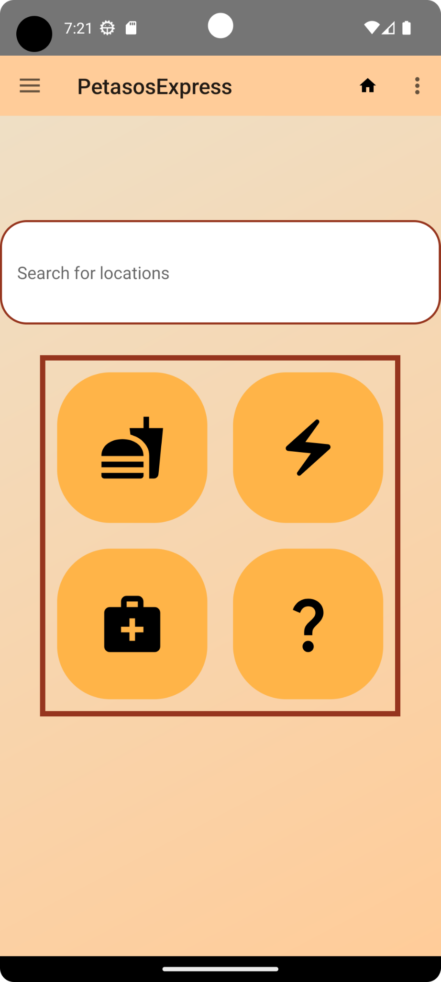
Home screen
Search Bar:
Provides users with a fast way to find extra locations and places to shop
Enables users to explore a wide range of options without navigating multiple screens
Quick Access Buttons:
Offers access to various food options, catering to different tastes and preferences
Showcases a wide range of electronic devices and gadgets
Displays essential medical items such as medications, first aid kits, and health supplies
Includes other categories like clothing, home appliances, beauty products, and more

Slide 8
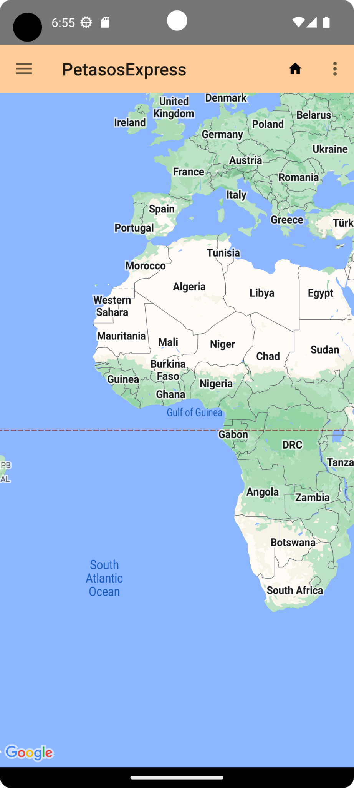
Gps Sensor screen
Dynamic Mapping:
Utilizes cutting-edge technology to showcase the real-time movement of our delivery robot on a dynamic map.
Offers users a live, animated display of the robot's path, allowing them to visualize its journey as it happens.
Interactive Exploration:
Empowers users with interactive controls, enabling effortless zooming in and out for detailed geographical perspectives.
Facilitates exploration of the surrounding area, allowing users to familiarize themselves with the robot's route and destination.

Slide 9
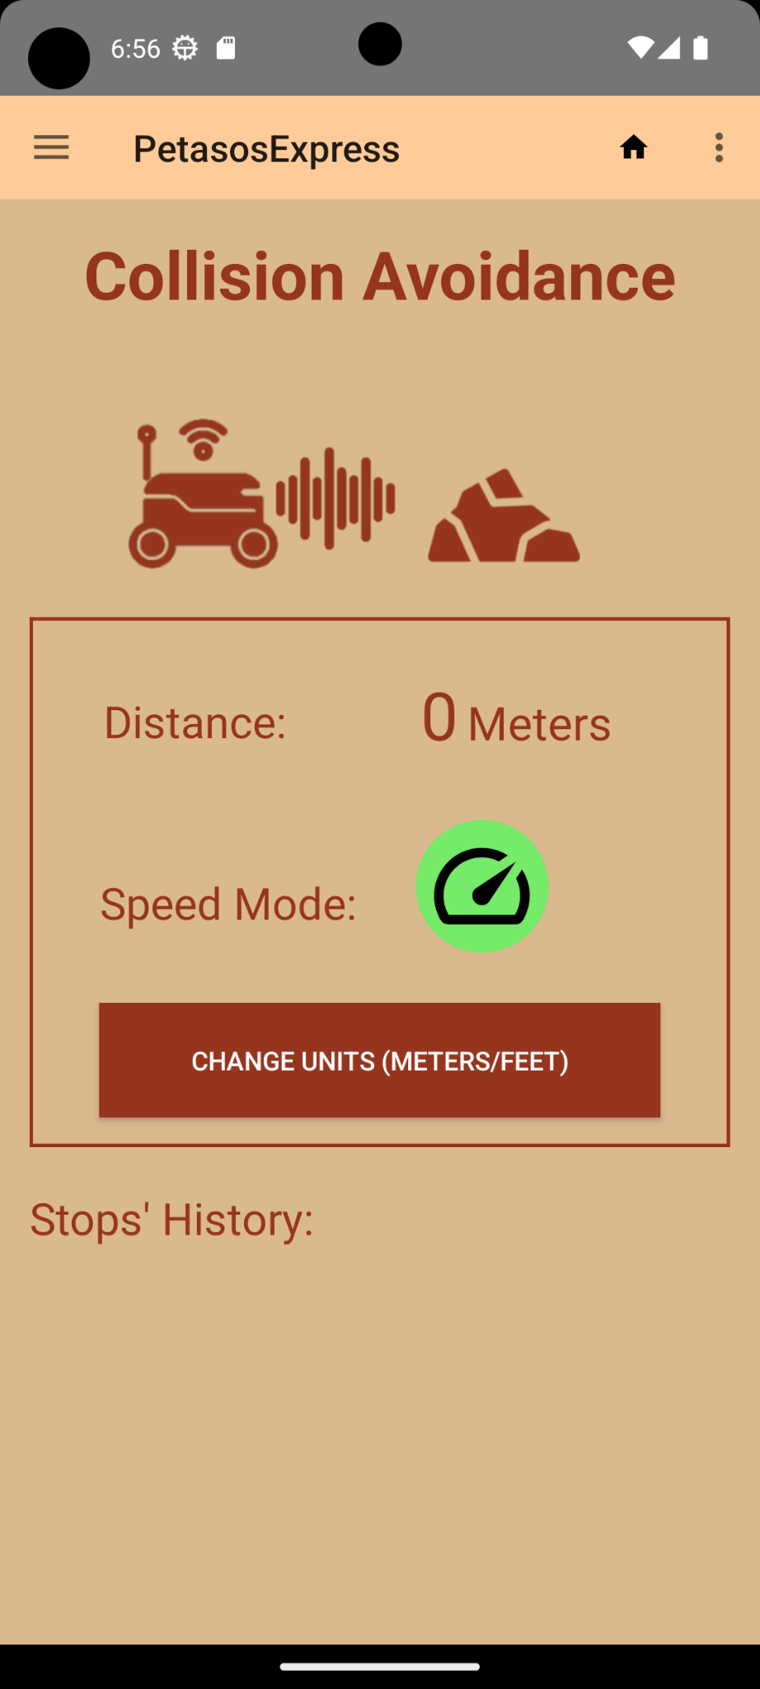
Distance sensor
Distance Measurement: The screen displays the real-time distance to the object in front of the robot (obtained from the ultrasonic sensor).
Status Indicators: Clear status indicators, such as "Maximum Speed," "Speeding Up," "Slowing Down," and "Stopped," are shown, allowing users to monitor the current operating state of the delivery robot.
Historical Stops: A history section logs the robot's previous stops, including timestamps, allowing users to track its delivery progress and view the duration and locations of previous stops for reference.

Slide 10
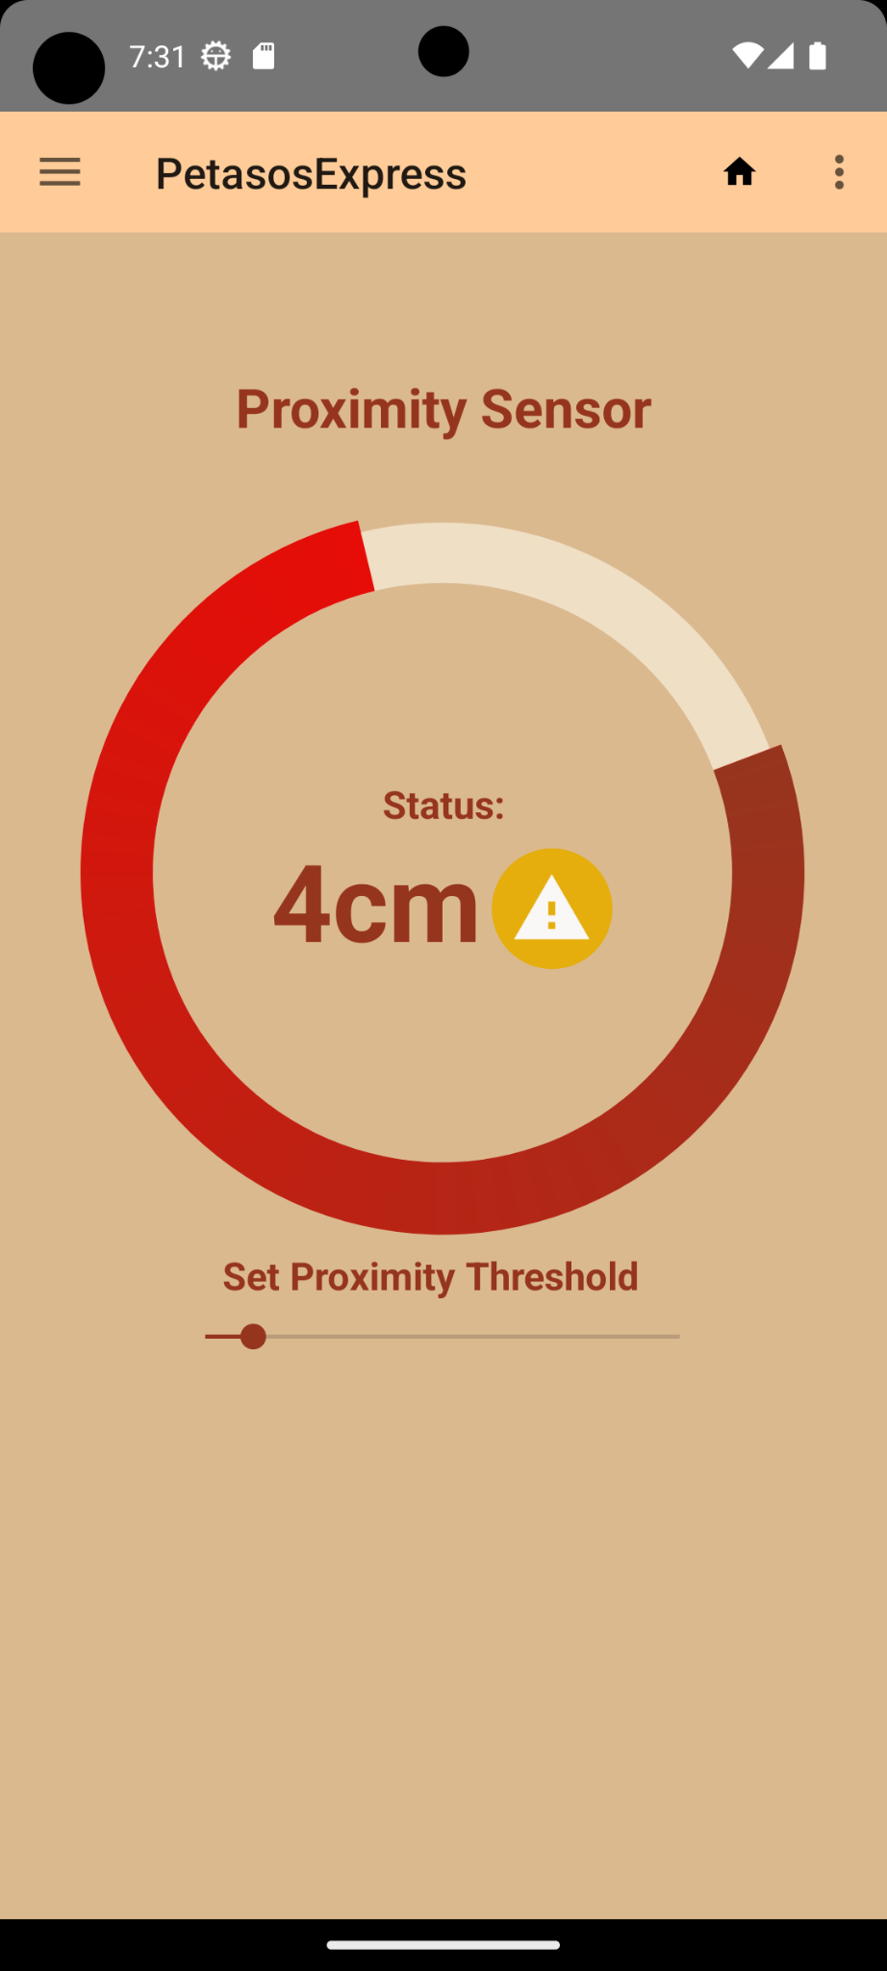
Proximity Sensor Screen
Sends alert if robot path is obstructed
Keeps record of previous errors/obstruction
Set distance for proximity threshold
Circular progress bar to represent distance
Robot stops if obstructed (status == error)
Error messages: ->

Slide 11
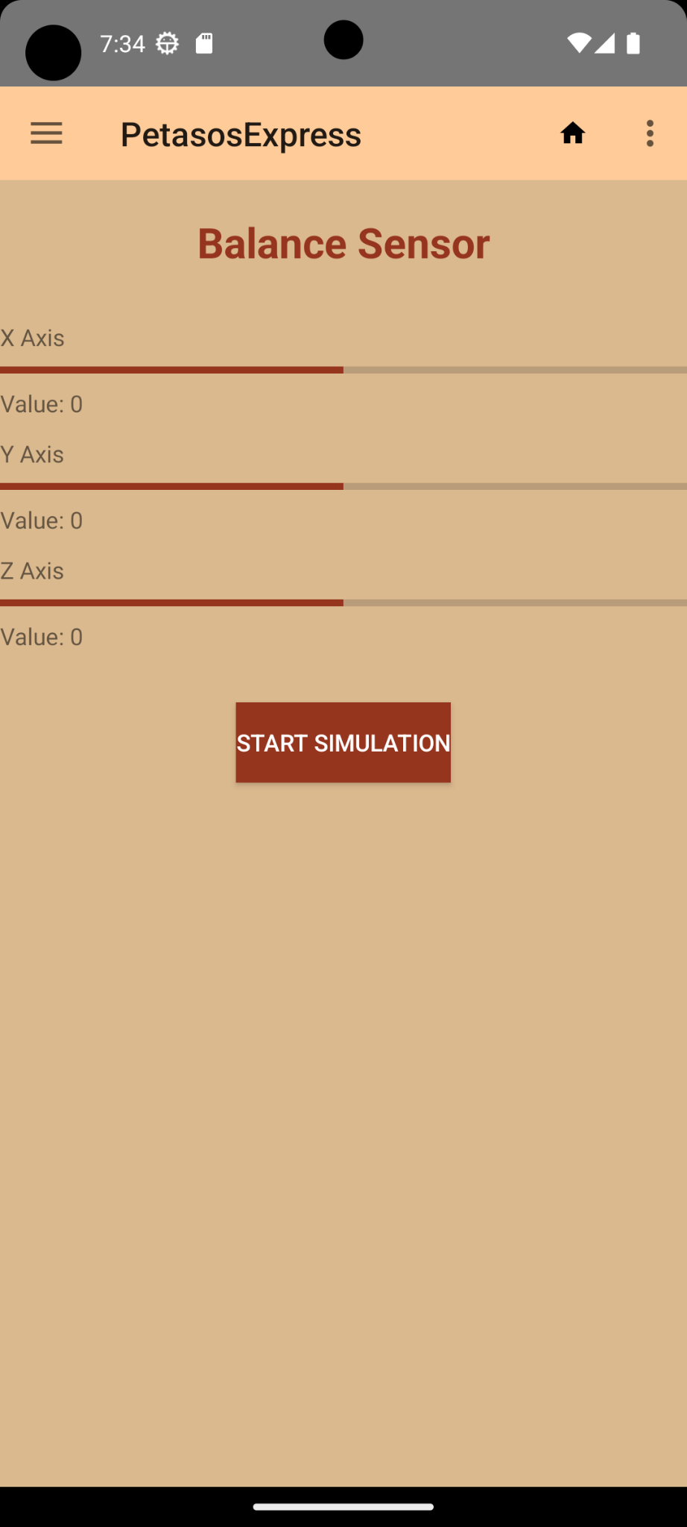
Balance Sensor Screen
X-Axis: Direction: represents the horizontal left-right direction.
Y-Axis: corresponds to the forward-backward horizontal direction.
Z-Axis: Represents the vertical up-down direction.
Together, the readings from these three axes provide a comprehensive view of the magnetic environment surrounding the robot. This 3D magnetic field data allows the robot to make informed decisions about its orientation and can be used to detect nearby magnetic disturbances.

Slide 12
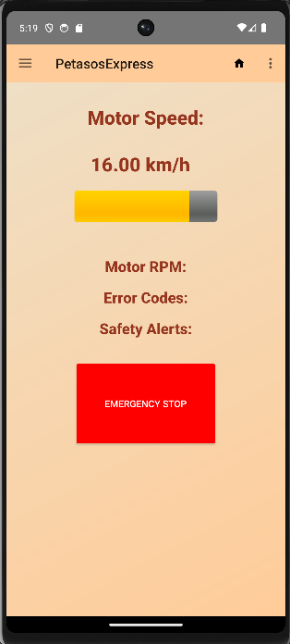
Motors sensor
Real-Time Updates:
Provides real-time feedback on motor speed changes
Dynamic Speed Display:
Mimics carrying conditions the speed the motors follows
Standard unit speed (kilometers per hour) & RPM
Interactive Button:
Offers the user a safe stop emergency function
Safety/ Error Updates:
Enhances user experience by providing informative error notifications.

Slide 13
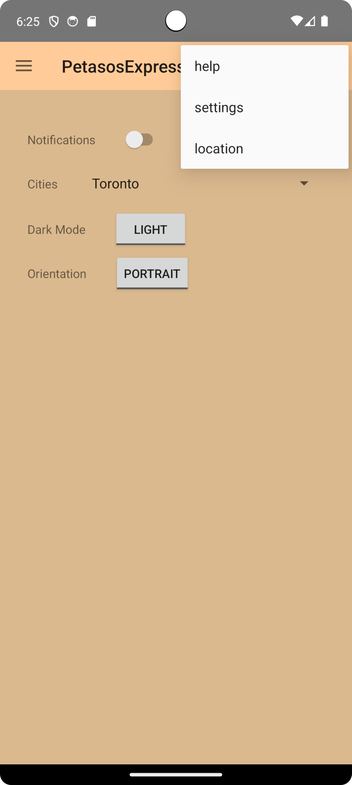
Settings and Top Menu Screens
Settings Screen:
Notifications Control: Toggle notifications on/off for personalized updates.
Location Selection: Customize app content based on city location.
Visual Preferences: Switch between dark mode and light mode effortlessly.
Orientation Choice: Opt for preferred screen orientation: portrait or landscape.
Menu Screen:
Home icon for quick access, ensuring users can always navigate back to the main screen.
Help Option: Easily accessible for users seeking customer support for more information about their delivery
Settings Option:Allows users to access the setting screen
Location Option: Allows users to access or modify location setting

Slide 14
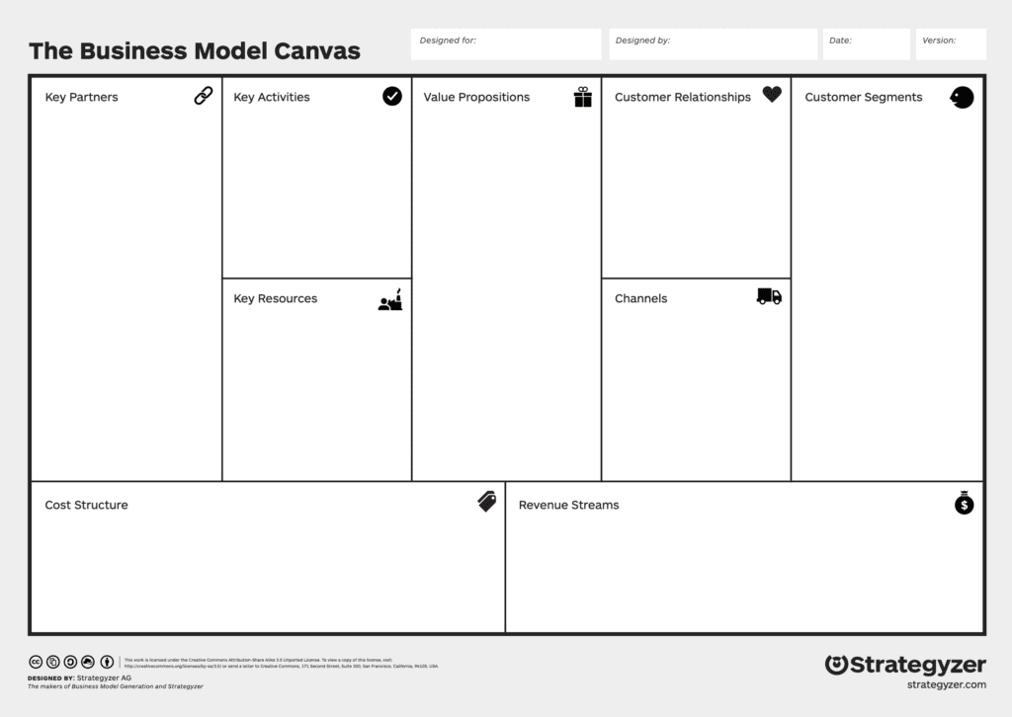
PetasosExpress
Hermes Logistics
Oct. 6th
- Local businesses; - Restaurants; - Mail companies
(ex. Canada Post);
- Warehouse Facilities (ex Amazon);
- Government and regulators;
- Keep Prices
Competetive;
- Expand Customer base;
- Maintain and expand partnerships;
- Maintain our platform;
-
- Eco-friendliness;
- Independence from human factors;
- Cashless payments;
- Self Service
-Troubleshooting support
- Individual Stores and companies;
- Remote Workers;
- Elderly,
- Network Connectivity and availability
- Gathered Data;
- Engineers and other staff;
- Delivery Robots;
- Free media coverage;
- Social Media;
- Word of Mouth;
- Advertisement;
- Platform maintenance;
- Robots maintenance;
- Transaction fees;
- Subscription with local businesses;
- Markup on items;
- Service and transactions fee;

Slide 15
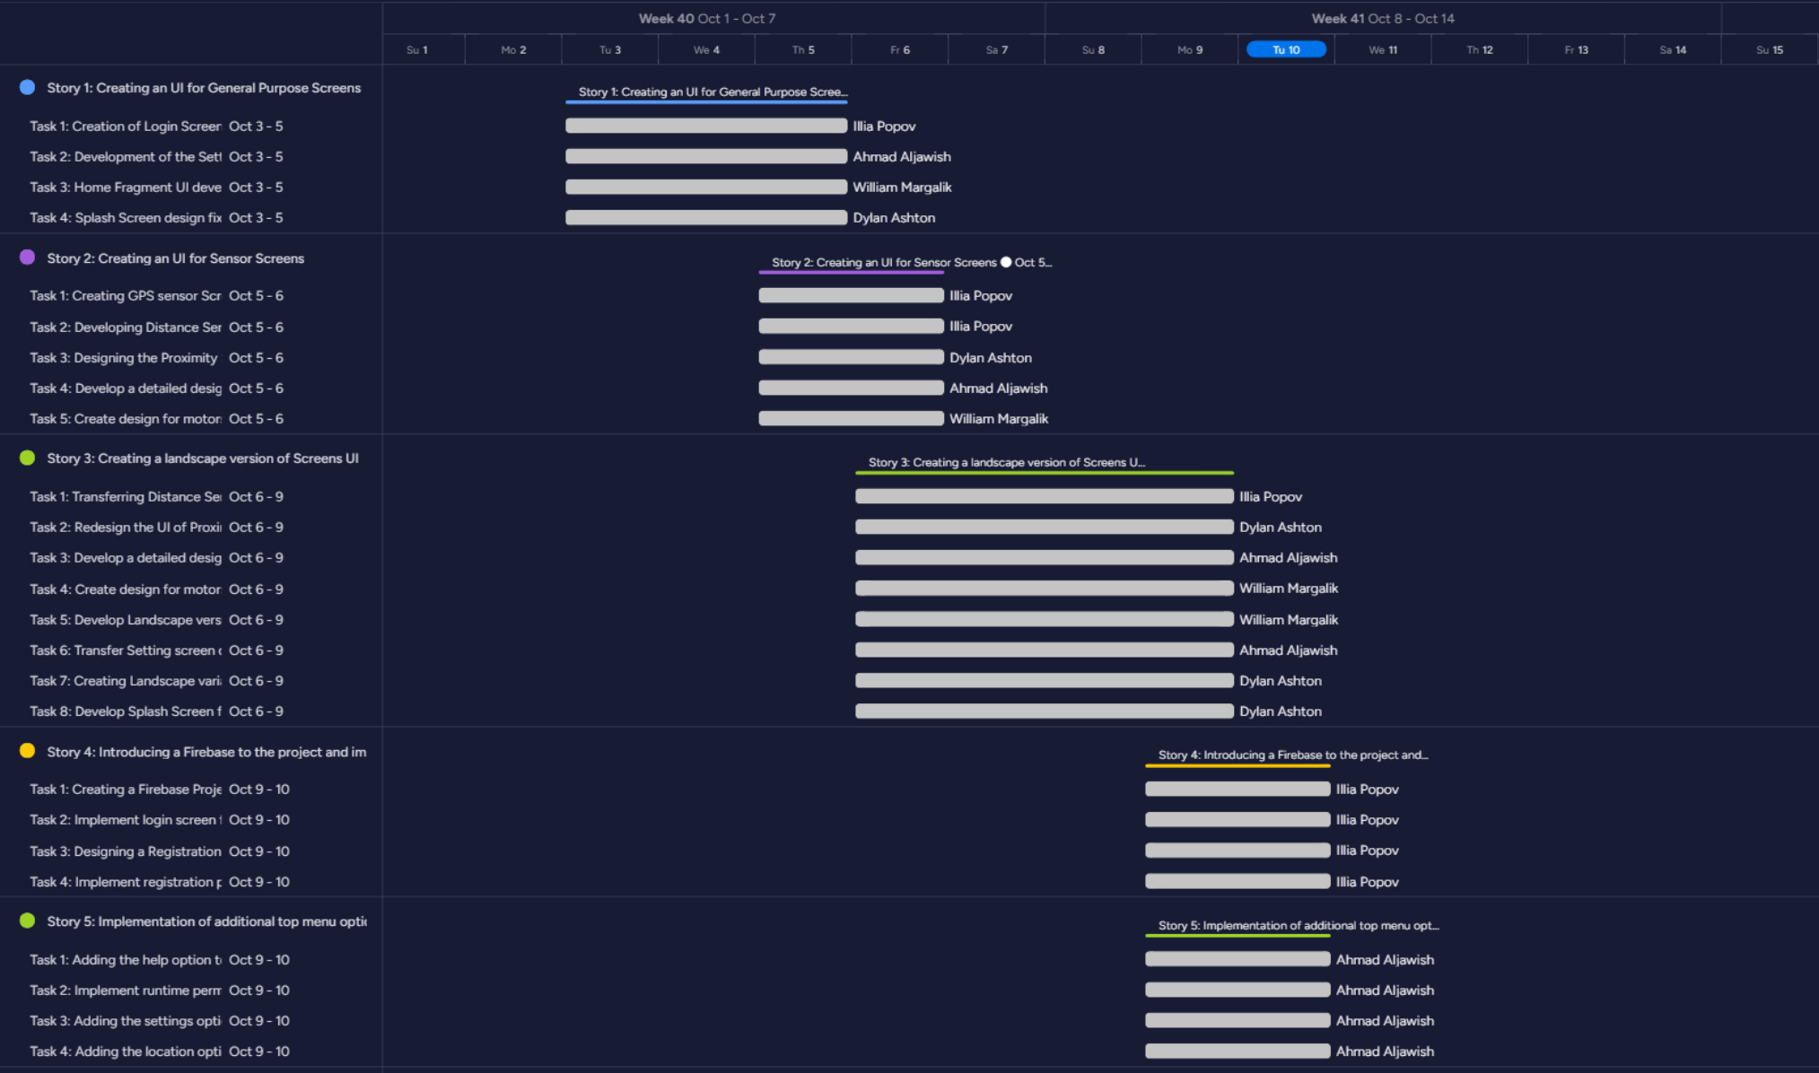
Our Gantt Chart

Slide 16
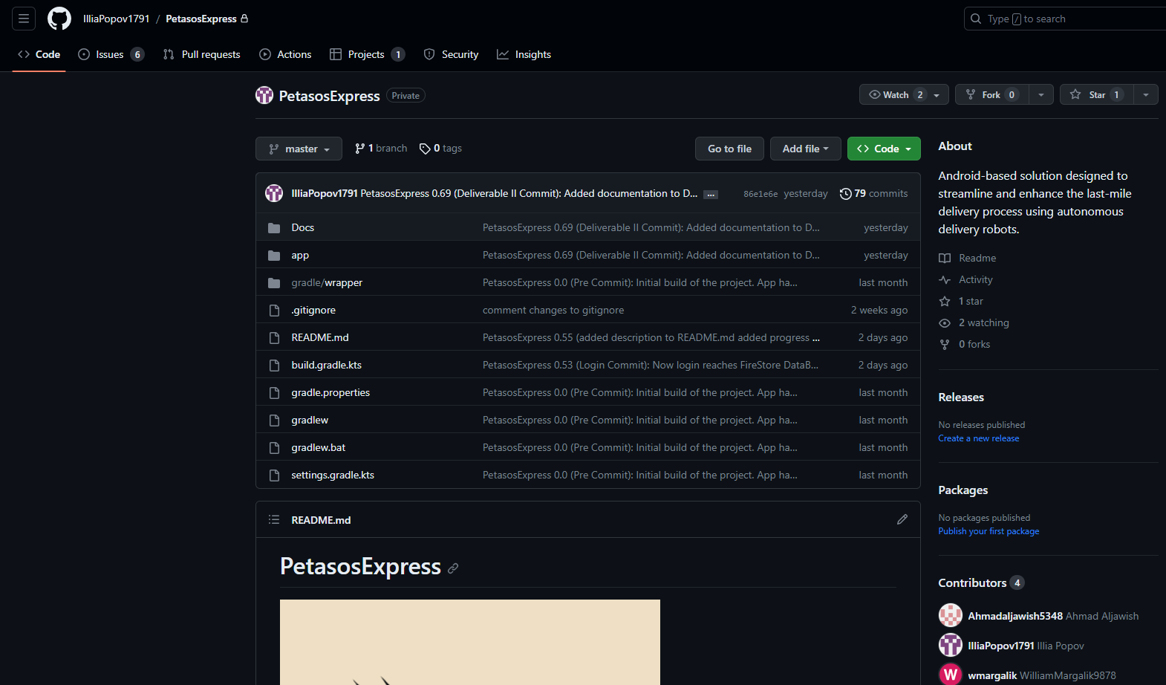
How github was implemented
Collaboration: GitHub's pull requests and reviews promote team discussion, code quality, and consistency.
Version Control: GitHub tracks and manages project changes, allowing simultaneous work without conflicts.

Slide 17
Why choose us versus our competitors?
Elevate your delivery experience with PetasosExpress, where innovation meets convenience. Unlike traditional services relying on human drivers, our cutting-edge robotic fleet glides effortlessly from one point to another, unhindered by traffic or other earthly obstacles. Embrace the future of logistics - swift, reliable, and hassle-free. Your packages, our priority.

Slide 18
Your Questions Matter!
We genuinely care about your inquiries. Your questions guide us, shaping PetasosExpress into a groundbreaking delivery solution. The more you ask, the better we can adapt, making this app the future of delivery – a collaborative effort with all of you. So please, don't hesitate to share your thoughts and questions!

